Slide 1
CSCE 5520
Wireless Networks and Protocols
1

Slide 2
Evolution of Cellular Wireless Systems
2

Slide 3
GSM Multiple Access Example
Combination of FDMA and TDMA
» More on this later
890-915 MHz for uplink
935-960 MHz for downlink
Each of those 25 MHz bands is sub divided into 124 single carrier channel of 200 KHz
» Each with a data rate of 270.833 kbps
In each uplink/downlink band there is a 200 KHz guard band
Each 200 KHz channel carries 8 TDMA channels
3

Slide 4
Additional GSM Features
GSM uses GMSK modulation
» Gaussian Minimum Shift Keying
» Optimized version of Frequency Shift Keying (FM)
Slow frequency hopping: successive TDMA frames are sent over a different frequency
» Switches every 4.615 msec
» Spreads out effect of multipath fading
» Also helps with co-channel interference
Delay equalization
» Mobile stations sharing a frame can be at different distances from the base station
» Tail bits and guard bits provide margin to avoid overlap
4

Slide 5
Generalized Packet Radio Service (GPRS)
Packet-oriented data transport service
» Bursty, non-periodic traffic typical for Internet access
Uses a new architecture for data traffic
» Allows users to open a persistent data connection
» Sending data traffic over a voice connection would add too much setup and teardown overhead
Uses the same frame structure as voice
» 21.4 kbps from a 22.8 kbps gross data rate
» Can combine up to 8 GSM connections
– Overall throughputs up to 171.2 kbps
» Enhanced Data Rates for GSM Evolution (EDGE) further increased rates using a more aggressive PHY
5

Slide 6
GPRS Architecture
Network Subsystem includes several new entities:
Serving GPRS Support Node (SGSN): data transfer between Base Station and Network Subsystem
Gateway GPRS Support Node: connects to other GPRS networks and the packet data network (Internet)
New interfaces between the various entities
Transmission plane
Data packets are transmitted by a tunnel mechanisms
Control plane
Protocol for tunnel management: create, remove, …
GPRS Tunnel Protocol
Radio interface
Changes the logical channels and how they are managed
6

Slide 7


GPRS Architecture
Other GPRS networks
…
SGSN
Gp
GGSN
Gp
Gn
BSC
Gf
Gs
BTS
Gr
Gc
GGSN
Gi
PDN
BTS
EIR
D
MT
HLR
MSC/VLR
Base Station Subsystem
SGSN – Serving GPRS Support Node GGSN – Gateway GPRS Support Node
7

Slide 8
GPRS Radio Interface
Time Slot
0 1 2 3 4 5 6 7 0 1 2 3 4
F1
F2
F3 F4
Uplink
0 1 2 3 4 5 6 7 0 1 2 3 4
Carrier frequency
F1
F2 F3 F4
Downlink
User1 Voice User2 Voice
User3 GPRS User4 GPRS
User5 GPRS
8

Slide 9
Evolution of Cellular Wireless Systems
9

Slide 10
Who is Who
International Telecommunications Union (ITU) - agency of the United Nations responsible for:
» Assisting in the development and coordination of world- wide standards
» Coordinate shared use of the global spectrum
» Defined the International Mobile Telecommunications 2000 (IMT-2000) project for 3G telecommunications
Third Generation Partnership Project (3GPP)
» A group of telecommunications associations that represent large markets world-wide
» Defined a group of 3G standards as part of the IMT-2000 framework in 1999
» Originally defined GSM, EDGE, and GPRS
» Later defined follow-on releases and also LTE (4G)
10

Slide 11
UMTS and WCDMA
Part of a group of 3G standards defined as part of the IMT-2000 framework by 3GPP
Universal Mobile Telecommunications System (UMTS)
» Successor of GSM
W-CDMA is the air interface for UMTS
» Wide-band CDMA
» Originally 144 kbps to 2 Mbps, depending on mobility
Basically same architecture as GSM
» Many GSM functions were carried over WCDMA
» But they changed all the names!
11

Slide 12
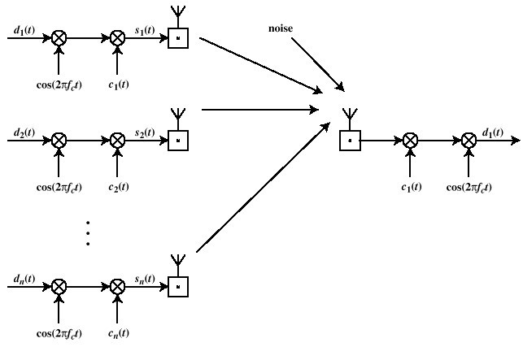
Reminder: CDMA - Direct Sequence Spread Spectrum
These signals will look like noise to the receiver
Pe
ter A. Steenkiste, CMU 13

Slide 13
Later Releases Improved Performance
High Speed Downlink Packet Access (HSDPA):
1.8 to 14.4 Mbps downlink
» Adaptive modulation and coding, hybrid ARQ, and fast scheduling
High Speed Uplink Packet Access (HSUPA): Uplink rates up to 5.76 Mbps
High Speed Packet Access Plus (HSPA+): Maximum data rates increased from 21 Mbps up to 336 Mbps
» 64 QAM, 2×2 and 4×4 MIMO, and dual or multi-carrier combinations
Eventually led to the definition of LTE
13

Slide 14
Advantages of CDMA for Cellular systems
Frequency diversity – frequency-dependent transmission impairments have less effect on signal
Multipath resistance – chipping codes used for CDMA exhibit low cross correlation and low autocorrelation
Privacy – privacy is inherent since spread spectrum is obtained by use of noise-like signals
Graceful degradation – system only gradually degrades as more users access the system
14

Slide 15
Mobile Wireless CDMA Soft Hand-off
Soft Handoff – mobile station temporarily connected to more than one base station simultaneously
Requires that the mobile acquire a new cell before it relinquishes the old
More complex than hard handoff used in FDMA and TDMA schemes
15

Slide 16
Evolution of Cellular Wireless Systems
16

Slide 17
Overview LTE
Motivation
Architecture
Resource management
LTE protocols
Radio access network
» OFDM refresher
LTE advanced
Some slides based on material from
“Wireless Communication Networks and Systems”
© 2016 Pearson Higher Education, Inc.
17

Slide 18
Purpose, motivation, and approach to 4G
Defined by ITU directives for International Mobile Telecommunications Advanced (IMT-Advanced)
All-IP packet switched network.
Ultra-mobile broadband access
Peak data rates
» Up to 100 Mbps for high-mobility mobile access
» Up to 1 Gbps for low-mobility access
Dynamically share and use network resources
Smooth handovers across heterogeneous networks
» 2G and 3G networks, small cells such as picocells, femtocells, and relays, and WLANs
High quality of service for multimedia applications
18

Slide 19
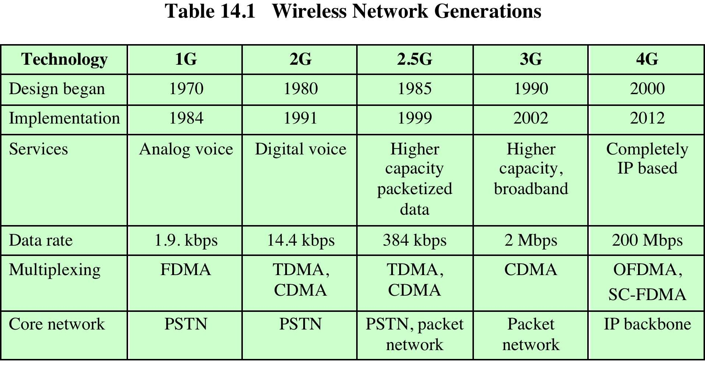
High Level Features
No support for circuit-switched voice
» Instead providing Voice over LTE (VoLTE)
Replace spread spectrum/CDMA with OFDM
20
Peter A. Stee
nkiste, CMU

Slide 20
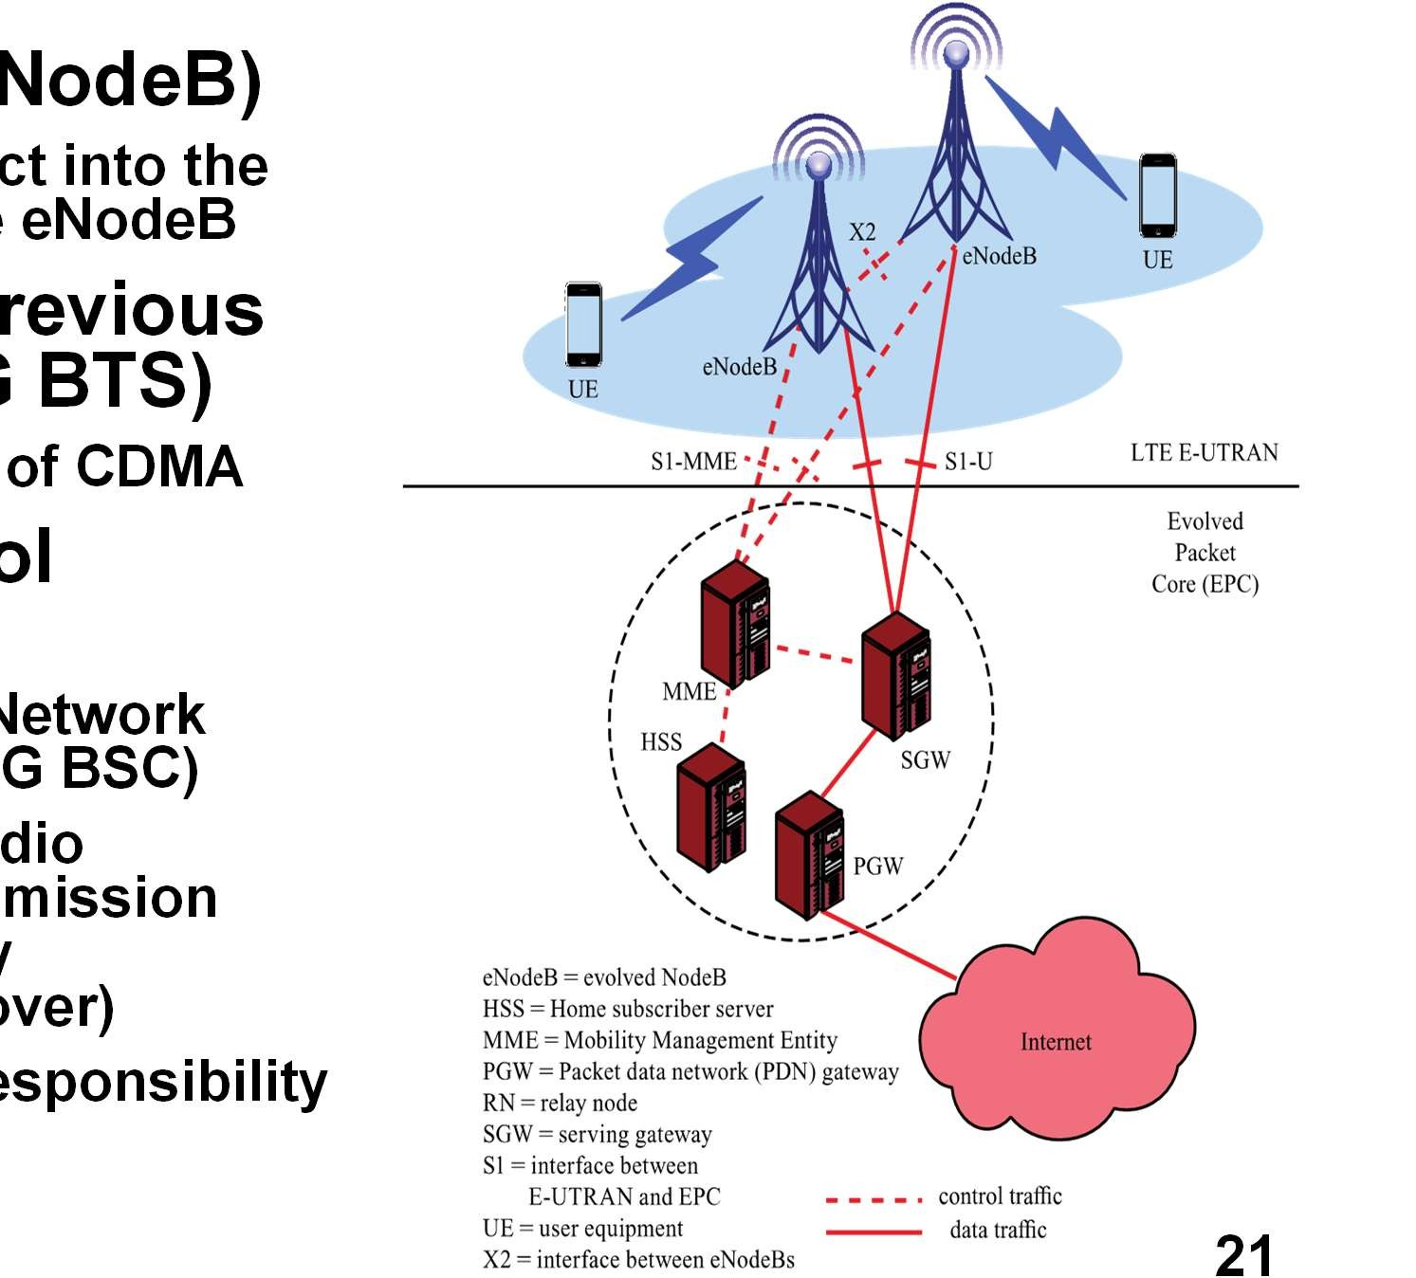
LTE Architecture
evolved NodeB (e
» Most devices conne network through the
Evolution of the p 3GPP NodeB (~2
» Uses OFDM instead
Has its own contr functionality
» Dropped the Radio Controller (RNC - ~2
» eNodeB supports ra resource control, ad control, and mobilit management (hand
» Was originally the r of the RNC
Radio Access Network
NodeB)
ct into the eNodeB
revious G BTS)
of CDMA
ol
Network G BSC)
dio mission y
over)
esponsibility
21
Core Network
Peter A. Steenkiste, CMU

Slide 21
Evolved Packet System
Overall architecture is called the Evolved Packet System (EPS)
3GPP standards divide the network into
Radio access network (RAN): cell towers and connectives to mobile devices
Core network (CN): management and connectivity to other networks
Each can evolve independently
» Driven by different technologies: optimizing spectrum use versus management and control or traffic
Peter A. Steenkiste, CMU

Slide 22
Evolved Packet System Components
Long Term Evolution (LTE) is the RAN
» RAN: Radio Area Network
» Called Evolved UMTS Terrestrial Radio Access (E-UTRA)
» Enhancement of 3GPP’s 3G RAN
» eNodeB is the only logical node in the E-UTRAN
» No Radio Network Controller (RNC)
Evolved Packet Core (EPC)
» Operator or carrier core network –core of the system
Traditionally circuit switched but now entirely packet switched
» Based on IP - Voice supported using voice over IP (VoIP)
Peter A. Steenkiste, CMU

Slide 23
Design Principles of the EPS
Packet-switched transport for traffic belonging to all QoS classes
» Voice, streaming, real-time, non-real-time, background
Comprehensive radio resource management
» End-to-end QoS, transport for higher layers
» Load sharing/balancing
» Policy management across different radio access technologies
Integration with existing 3GPP 2G and 3G networks
Scalable bandwidth from 1.4 MHz to 20 MHz
Carrier aggregation for overall bandwidths up to 100 MHz
Peter A. Steenkiste, CMU

Slide 24
Evolved Packet Core Components
Mobility Management Entity (MME)
» Supports user equipment context, identity, authentication, and authorization
Serving Gateway (SGW)
» Receives and sends packets between the eNodeB and the core network
Packet Data Network Gateway (PGW)
» Connects the EPC with external networks
Home Subscriber Server (HSS)
» Database of user-related and subscriber-related information
Interfaces
» S1 interface between the E-UTRAN and the EPC
For both control purposes and for user plane data traffic
» X2 interface for eNodeBs to interact with each other
Again for both control purposes and for user plane data traffic
Peter A. Steenkiste, CMU

Slide 25
Overview
Motivation
Architecture
Resource management
LTE protocols
Radio access network
» OFDM refresher
LTE advanced
Some slides based on material from
“Wireless Communication Networks and Systems”
© 2016 Pearson Higher Education, Inc.
Peter A. Steenkiste, CMU

Slide 26
LTE Resource Management
LTE uses bearers for quality of service (QoS) control instead of circuits
EPS bearers
» Between entire path between PGW and UE
» Maps to specific QoS parameters such as data rate, delay, and packet error rate
Service Data Flows (SDFs) differentiate traffic flowing between applications on a client and a service
» SDFs must be mapped to EPS bearers for QoS treatment
» SDFs allow traffic types to be given different treatment
End-to-end service is not completely controlled by LTE
Peter A. Steenkiste, CMU

Slide 27
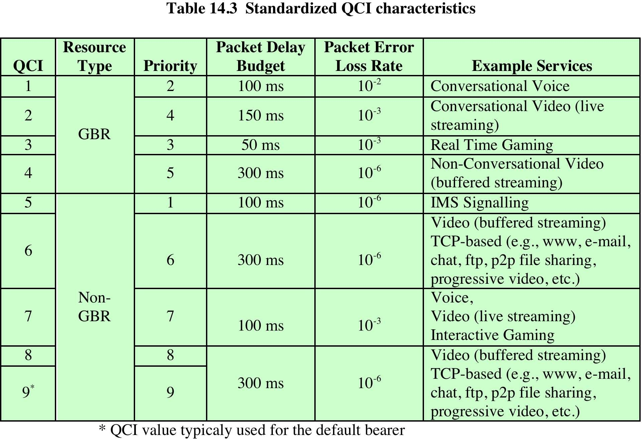
Bearer Management based on QoS Class Identifier (QCI)
Guaranteed (minimum) Bit Rate
No Guarantees
Peter A. Steenkiste, CMU

Slide 28
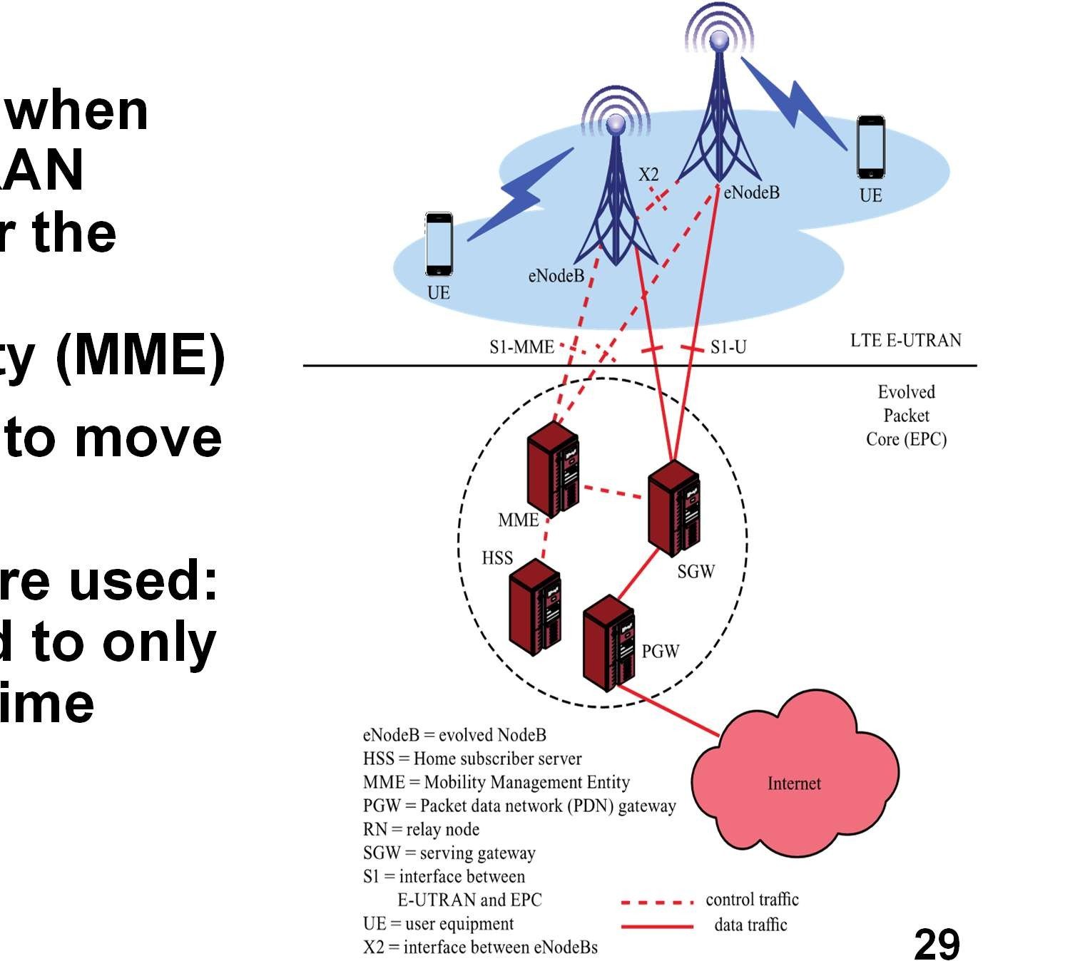
EPC: Mobility Management
X2 interface used when moving within a RAN coordinated under the same Mobility Management Entity (MME)
S1 interface used to move to another MME
Hard handovers are used: A UE is connected to only one eNodeB at a time
Peter A. Steenkiste, CMU

Slide 29
EPC: Inter-cell Interference Coordination (ICIC)
Reduces interference when the same frequency is used in a neighboring cell
Goal is universal frequency reuse
» N = 1 in “Cellular principles” lecture
» Must avoid interference when mobile devices are near each other at cell edges
» Interference randomization, cancellation, coordination, and avoidance are used
eNodeBs send indicators
» Relative Narrowband Transmit Power, High Interference, and Overload indicators
Later releases of LTE have improved interference control
» “Cloud RAN”: use a cloud to manage interference, spectrum
Peter A. Steenkiste, CMU

Slide 30
Overview
Motivation
Architecture
Resource management
LTE protocols
Radio access network
» OFDM refresher
LTE advanced
Some slides based on material from
“Wireless Communication Networks and Systems”
© 2016 Pearson Higher Education, Inc.
Peter A. Steenkiste, CMU

Slide 31
Protocol Layers End-to-End
Resource Management
Tunneling Service
Fancy L2 for Mobile to cell tower
Communication in EPC
Peter A. Steenkiste, CMU

Slide 32
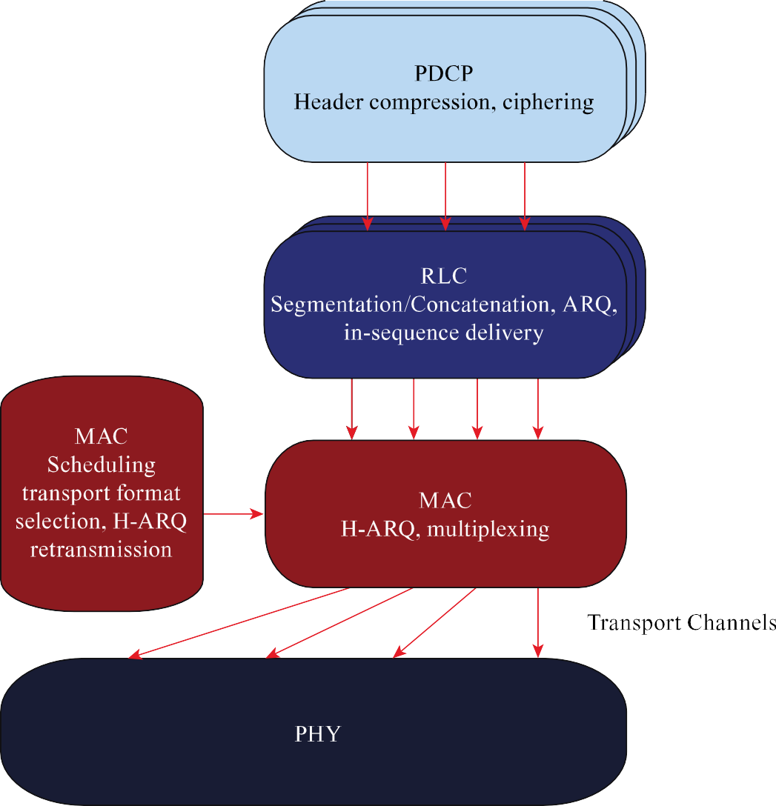
Protocol Layers PDCP and RLC
Packet Data Convergence Protocol (PDCP)
» Delivers packets from UE to eNodeB
» Involves header compression,
ciphering, integrity protection,
in-sequence delivery,
buffering and forwarding of packets during handover
Radio Link Control (RLC)
» Segments or concatenates data units
» Performs ARQ
Recover from when MAC layer H-ARQ failures
ARQ: Automatic Repeat Request (retransmission)
H-ARQ: Hybrid ARQ – combines FEC and ARQ
Peter A. Steenkiste, CMU

Slide 33

Protocol Layers MAC and PHY
Medium Access Control (MAC)
» Performs H-ARQ: combines FEC and retransmission (ARQ)
» Prioritizes and decides which UEs and radio bearers will send or receive data on which shared physical resources
» Decides the transmission format, i.e., the modulation format, code rate, MIMO rank, and power level
Physical layer actually transmits the data
Peter A. Steenkiste, CMU

